Slide 1
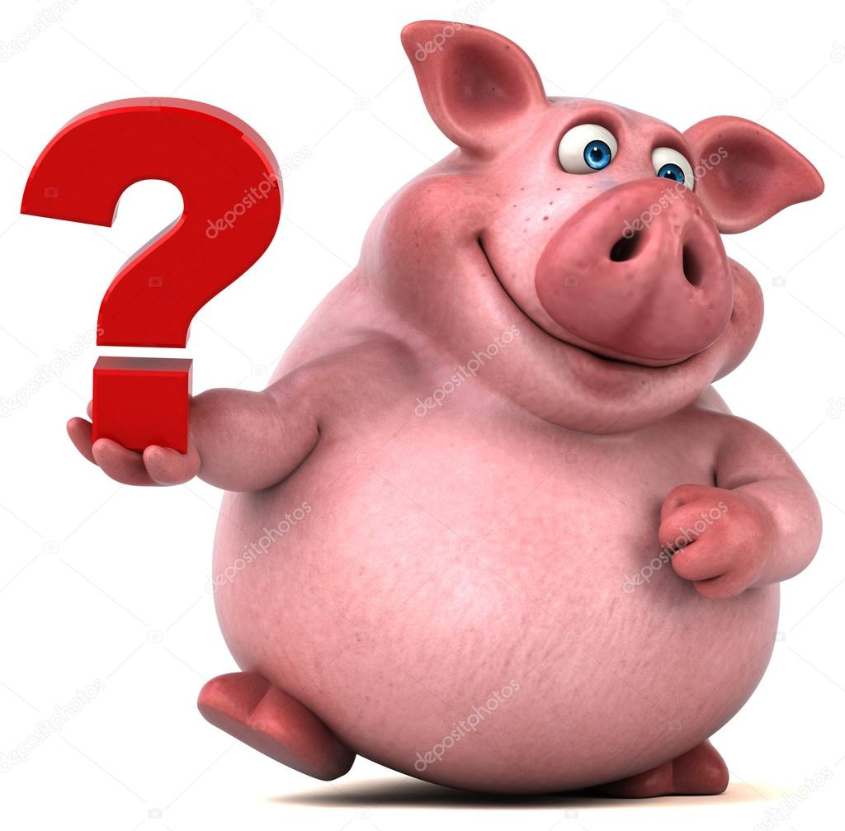
QUESTIONS Page 45
Question 1 10 X [1] = [10]
1. Adenosine Tri Phosphate (ATP) 2. Mitochondrion 3. GlycoLysis 4. Oxygen 5. Anaerobic 6. Chemical Energy 7. Cristae 8. Lactic Acid Fermentation 9. Oxidative Phosphorelation 10. Enzymes
Question 2
1. Mitochondrion [1]
2. A=PhotoSynthesis B=Respiration [2]
3. 2=Oxygen 3=Carbon dioxide 4= Oxygen 6=Carbon dioxide [4]
5=Glucose [1]
An alcohol called Ethanol + Carbon dioxide [3]

Slide 2
Question 3
Water. Glasstube. Thistle funnel. Germinating seeds. Clear lime-water. [5]
Active respiration is happening in all of them. [2]
The clear lime-water turns a milky-white colour. [2]
This is the Control – you boil them to kill the seeds. [2]
Exactly the same apparatus as for the Experiment, except that the seeds are dead – they cannot respire to release CO2. [3]
The process of Respiration releases carbon dioxide. [2]
Question 4
It absorbs carbon dioxide. [2]
Seeds are kept above the liquid, and gases can easily move between them. [2]

Slide 3
3. It moved, from A to B. [3]
The released gas (CO2) was absorbed by the potassium hydroxide. The seeds were sucking in oxygen. This caused the gas in the tube to be sucked in – as is shown by the coloured liquid. [4]
Question 5
Both involve glucose.
Both use ATP as the energy-carrier. [2]
Humans produce Lactic Acid
Yeast produces alcohol and CO2. [2]
3. Breaking down food to release energy, without using Oxygen. [2]
4. When we do excess exercise – lots of energy is needed, with not enough oxygen. [2]

